Slide 1
Waste Not, Want Not What it takes to effectively create an affective Plastics Recycling Program in your school ultimately increasing the use of refillable water bottles.
Plastic Team: Mac Noyes, Caitlyn Skalla and Lauren Cleveland
Notes:
What does it take to create a Plastics Recycling Program and ultimately increase the use of refillable water bottles

Slide 2
INTRODUCTION
It takes about 450 years for a plastic water bottle to decompose. That means if a plastic bottle is placed in the landfill today, it will take approximately 4.5 centuries or about 164,250 days to breakdown. In other words, that same water bottle will be around until 2466! Now that's something worth investigating!
What do you do when you see a trash can filled with plastic bottles and there is no recycling program in place? You develop a recycling program, that is what you do! What do you do to make sure these people understand the benefits of recycling? You put an awareness campaign in place educating them on the benefits of recycling and the benefits reusing refillable water bottles as opposed to disposable plastic water bottles. This experiment will prove how we successfully educated the students of River Ridge Academy Middle School on the benefits of recycling plastic bottles and reusing refillable water bottles.
By doing our part RRA will help reduce the amount of plastic placed in landfills and save on natural resources used to manufacture disposable plastics. In addition, by reusing refillable bottles, our students, staff and families will protect the earth and save money.
Notes:
One plastic water bottle put in a landfill will be around until 2466!
We saw the need at RRA by observing plastic water bottles thrown away in the trash cans. We decided to create a plastics recycling program but knew the only way for it to work was to
develop an Awareness Program to run along with it. By doing this we felt students would began refilling reusable water bottles in our Water Fountain Refill Stations. While our goal
was to get students, teachers and staff to recycle our ultimate goal was to help RRA understand that we needed to “reuse”.
This would not only reduce the amount of plastic water bottles placed in landfills and save on natural resources used in manufacturing it would protect the earth and save money.

Slide 3
BACKGROUND RESEARCH
The team observed that there were a lot of plastic water bottles being thrown away in the regular trash cans and wanted to do something about it. Research showed 1500 water bottles are consumed every second in the United States and 50 billion are purchased every year with over 80% ending up in landfills and not being recycled at all. America uses over 17 million barrels of crude oil manufacturing plastic water bottles. That is enough oil to fuel 1.3 million cars a year! To put it in perspective, ONE recycled plastic water bottle can power a 60w light bulb for 6 hours!
Not only did the research show plastic water bottles have a negative effect on the planet and natural resources, but, they have an impact on the wallet! The average cost of a gallon of bottled water is $1.22 versus a gallon of tap water costing $0.004. A 17oz water bottle sold at RRA concessions and cafeteria is $1; if that same person refilled a reusable water bottle in the water fountain refill station it would cost $0.0002! The math was amazing!
Once the facts were gathered, the Social Studies teachers were involved in surveying the middle school students. The biggest question to be answered, “Will you recycle”? An overwhelming number of students responded yes, if it were convenient. Classroom recycling centers were then placed in every middle school classroom.

Slide 4
BACKGROUND RESEARCH (Cont.)
Now it was time for the “Awareness Campaign” which included hanging posters around the school and performing a skit at the monthly huddle to share these findings with the staff and students. At the end of the huddle the challenge was issued to begin making a difference at River Ridge Academy, Reduce, Reuse and Recycle was the overall message.
To further the mission to recycle plastics on the RRA campus, Publix, a community partner was contacted. The General Manager, Brian Goldstein came to RRA to meet. While some of their providers “reuse” shipping containers others deliver in some type of paper or plastic packaging. He spoke about how much recycling Publix collects as a company from unpacking all the grocery and merchandise for their store. Publix not only “recycles” their trash to keep it from landfills but, they sell their trash for $96M per year! Mr. Goldstein agreed, beginning a recycling program was a step in the right direction for River Ridge Academy. (Publix delivered a container within 10 days for use in one of the common areas.)

Slide 5
HYPOTHESIS
If plastic recycling centers are placed in the classrooms and common areas around the school, then the amount of plastic bottle recycling will increase on the River Ridge Academy campus.
Dependent Variable: place plastic recycling centers in classrooms and common areas around the school
Independent Variable: increase the amount of recycling of plastic bottles on our campus
B. If an “Awareness Campaign” is put in place to educate the students and staff of River Ridge Academy, then there will be an increase in refilling reusable water bottles at the water fountain refill stations
Dependent Variable: “Awareness Campaign” to educate the students and staff of River Ridge Academy
Independent Variable: there will be an increase in refilling reusable water bottles at the water fountain refill stations

Slide 6
CONTROL
In this experiment the Middle School of River Ridge Academy will be used as their recycling efforts are recorded once Recycling Centers are placed in their classrooms and “Awareness Campaigns” have begun.
The 2nd grade of River Ridge Academy will be used as the control for this experiment as they will be left on their own to recycle after the Awareness Campaigns are begun. No recycling centers will be placed in their classrooms.

Slide 7
RIVER RIDGE ACADEMY PLASTIC WATER BOTTLE SURVEY
MATERIALS NEEDED FOR A CLASSROOM SURVEY
*Note: Need the same number of surveys as people to be surveyed
1. Do you bring a disposable water bottle to school? (For example: Dasani, Publix, Aquafina) Yes or No
2. Do you normally throw your plastic water bottles in the trash? Yes or No
3. Do you feel that recycling is important? Yes or No
4. Do you recycle? Yes or No
*If you do recycle, how often do you recycle your trash?
Always Only when it is convenient/visible Never
*If recycling was more convenient and readily available, would you do it?
Yes or No
Notes:
We did it because we needed to know if people knew what recycling •♋••

Slide 8
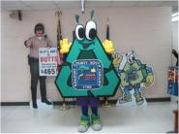
PREPARING AN EDUCATIONAL SKIT
. Speak with the school principal or classroom teacher, find an event where the most students will be reached
. Meet to outline important facts that need to be included
. Create a dialog and assign parts to each team member
. Involve the audience by picking a “catchy song” or cheer
. Design and build props for the skit that explain the message (Use as many recycled/reused materials as possible)
. Ask a member of the community to join the presentation to add importance or interest
. PRACTICE, PRACTICE, PRACTICE
. Arrive early to make sure the stage is properly set
. When it is time to perform, make sure all performers speak slowly and clearly
. At the end, issue the challenge, bow and thank everyone for their time
Beaufort County Waste mascot, Rerun joined us for our school wide Huddle to help with the importance of the “plastic recycling challenge”.

Slide 9
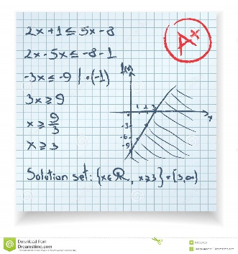
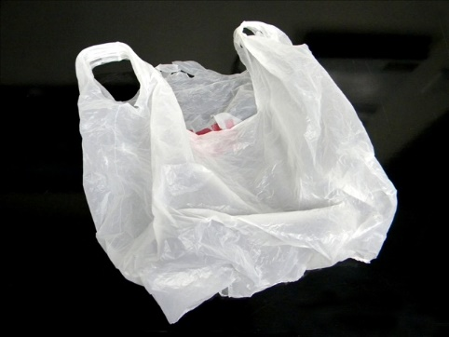
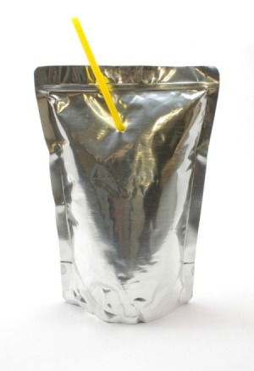
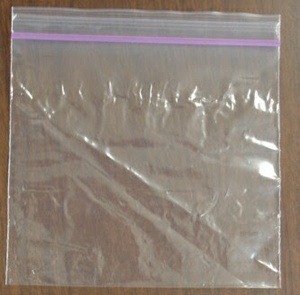
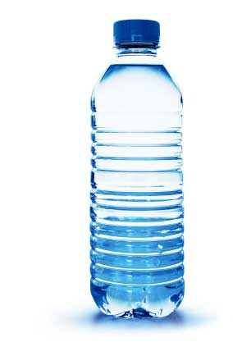
!!!!SHOCKERS!!!! FACT 1: 1,500 bottles of water are consumed every second. FACT 2: Every day the United States uses 90,000 feet of paper. FACT 3: 17,000,000 barrels of oil are used to produce water bottles ever year. That would heat and cool 190,000 homes and fuel 1,000,000 cars for 1 year. FACT 4: If all our newspaper was recycled we would save 250M trees per year. FACT 5: If you lined up all the water bottles that are not in recycled in 1 day you could go from San Francisco, CA to New York City and back. That totals 5,127.6 miles! That’s over 1,868,506.4 miles per year! FACT 6: 2B trees are used each year to produce paper products in the United States. That means each year RRA uses 7,000 trees and you personally use 7 trees. FACT 7: It takes about 6 decades or 60 years for a water bottle to decompose in the landfill. FACT 8: Each person in the United States uses about 680 pounds of paper per year.
EDUCATIONAL SKIT
SAMPLE SCRIPT
Slide #1
Slide #2
Old School Papers
Campaign Posters
Plastic Grocery Bag
Juice Pouch
Plastic Sandwich Bag
Plastic Water Bottles

Slide 10
RAIDER CHALLENGE
EDUCATIONAL SKIT SAMPLE SCRIPT (Page 2)
Slide #3
Join us for the 1st RRA Campus and Bluffton Parkway Cleanup
Saturday, November 14th from 1p to 3p
Be mindful…..Please Reduce, Reuse & Recycle
Slide #4
River ridge raiders your mission REDUCE, REUSE & RECYCLE

Slide 11
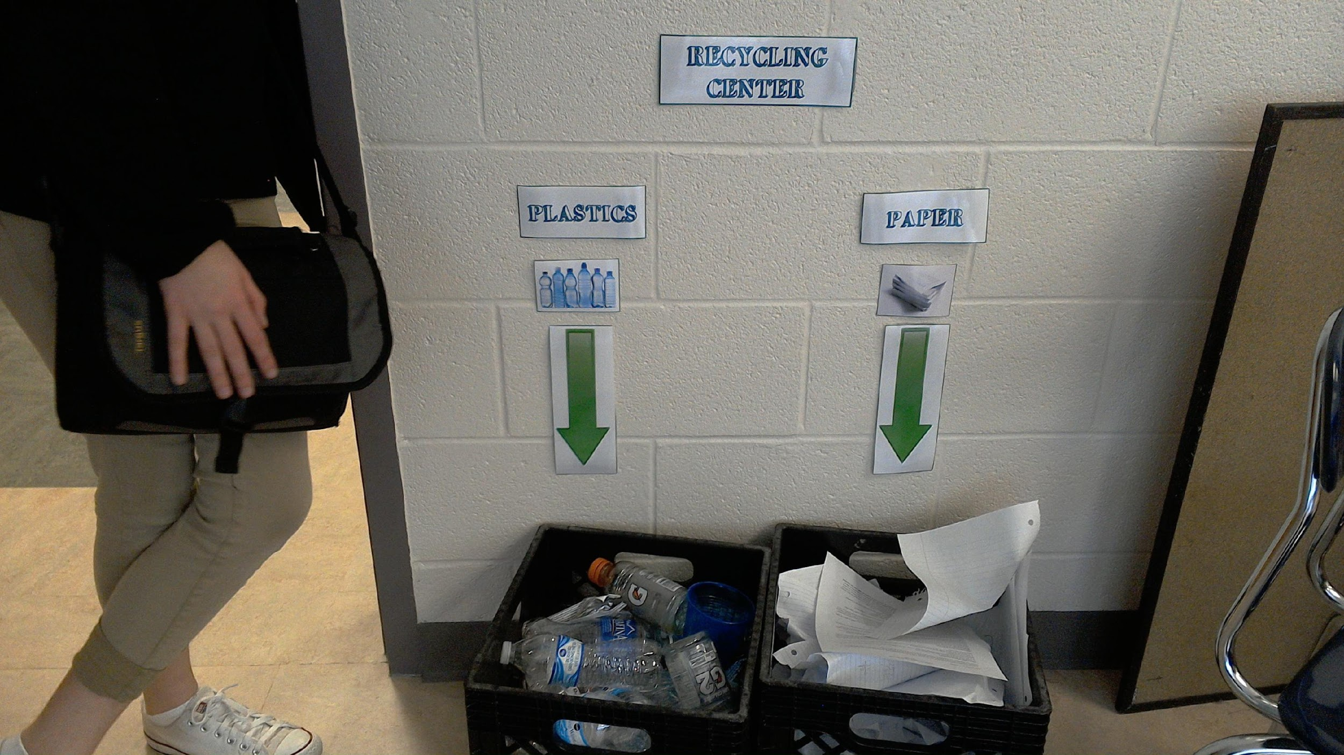
MATERIALS NEEDED FOR CLASSROOM RECYCLE CENTER
*Note: Before beginning this project make sure you look around for reusable containers. These materials will provide 2 bins (1 for plastic and 1 for paper) for 15 classroom recycle centers.
30 Milk Crates (Reused from the Cafeteria)
60 Pieces of White Card Stock
Paper Cutter
Printer
Completed Classroom Recycling Center

Slide 12
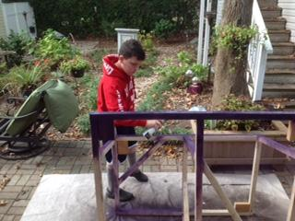
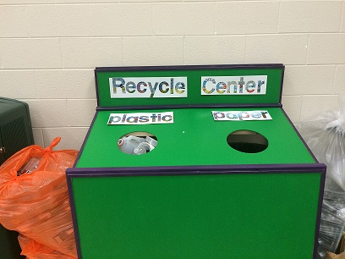
MATERIALS FOR COMMON AREA RECYCLING CENTER
(4) 2x2 Pine Boards (8’ Long)
(1) ¼” 4x8 Sheet of Plywood
(2) 8’ Furring Strips
(2) 8’ Pieces of ½” Corner Trim
(40) Wood Screws
(20) Finishing Nails
(4) Cans of Green Spray Paint
(1) Quart of Purple Paint
12’ of Rubber Tubing
Labels: (28) Juice Pouches, (3) Sheets of Cardstock
Building Recycling Center
Finished Product

Slide 13
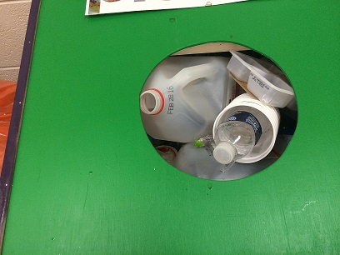
RIVER RIDGE RAIDERS RECYCLE
This is the recycling center built for the River Ridge Academy Cafetorium. It is used during school and at after hour events. The maintenance staff has joined in and is helping us with getting our recycling to the outside pickup area. Her name is “Marita”.
In the above picture, the orange bag to the left and the clear bag to the right of the center show plastic bottle recycling that was done at a school event for fathers and their students. Everyone is pitching in at RRA to do their part!!!!

Slide 14
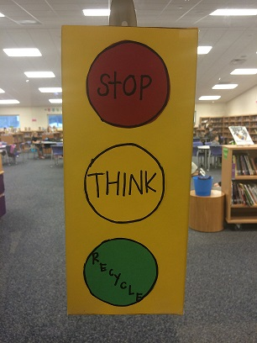
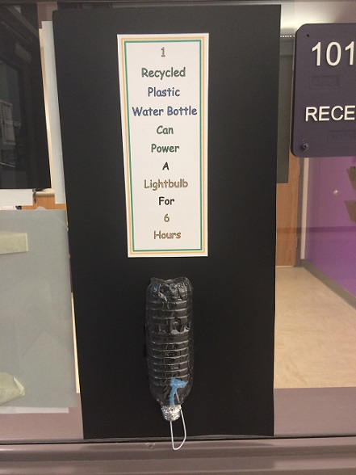
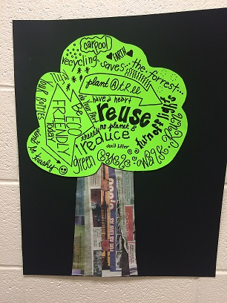
MATERIALS NEEDED TO CREATE POSTERS
INSPIRATION
½ Sheet of Cardboard
Markers/Colored Pencils/Crayola Crayons
Scissors
Glue
Pencil
Tape
Pen
Miscellaneous Repurposed Items
(juice pouches, empty plastic bottles, colored paper, newspaper, shoe box lid etc.)
Shoe Box Lid
Plastic Water Bottle
Newspaper

Slide 15
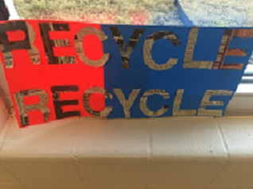
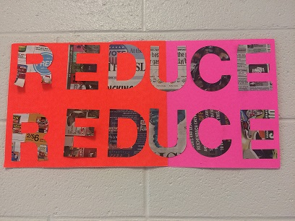
REUSABLE WATER BOTTLE AWARENESS POSTER CAMPAIGN
Sample of recycling awareness posters placed throughout RRA Campus
Made from past election posters and newspaper

Slide 16
HOW TO INVOLVE THE COMMUNITY
Identify community members that share a common goal. It was important that the recycling centers had recognizable symbols and perhaps a company name. Publix was asked to become involved because they have recycling bins in front of every store. When checking out a website you will find out who the general manager is for the store. Contact them to set an appointment.

Slide 17
AGENDA USED FOR PUBLIX MEETING
*When creating an agenda, make sure to cover your topic in an organized fashion. This way the meeting will run smoothly.
River Ridge Raiders Recycle
December 17, 2015
INTRODUCTION (Lauren Cleveland)-What is eCybermission?
*eCybermission is a virtual science fair sponsored by the US Army.
WHAT IS OUR MISSION? (Caitlyn Skalla)
*We have chosen a mission for the environment relating to recycling of plastic materials. We are working to make a difference in our community, both inside and outside of our school.
WHY WE HAVE ASKED YOU HERE TODAY? (Mac Noyes)
*During our mission we noticed Styrofoam trays are being used in our lunch room. We found out that our school cafeteria uses about 450 of these trays per month.
STYROFOAM FACT-(Lauren Cleveland)
*When placed in a landfill, Styrofoam disintegrates in 500 years to never!!!!
WE NEED YOUR HELP-(Caitlyn Skalla)
*We are asking Publix to partner with River Ridge Academy because of your success in recycling egg cartons and meat trays. We would like to bring our trays to your store and recycle them.
WE WILL……(Mac Noyes)
*We will clean the lunch trays and deliver them to Publix every 4 to 6 weeks.
Will you partner with our Plastics Recycling team?

Slide 18
METHODS/PROCEDURES FOR CONDUCTING EXPERIMENT
Step 1-Visual observations of classroom trashcans to determine the number of plastic water bottles thrown away.
Step 2-Develop plastics recycling survey and distribute to Social Studies teachers.
Step 3-Analyze surveys to determine results.
Step 4-Begin educating students and faculty on the benefits of recycling by performing a skit at a student gathering.
Step 5-Collect “reusable” materials, when available, to build classroom recycling centers and gather other materials to complete centers, clearly labeling the purpose of each container.
Step 6-Place recycling centers in classrooms in a convenient location.
Step 7-Continue education by placing posters throughout your campus and promote refilling reusable water bottles.
Step 8-Involve community members to help create credibility for plastic recycling on and off campus.
Step 9-Build central recycling center for common area to help increase convenience of plastic recycling and place in common area .
Step 10-Pick up recycled plastic bottles in the classrooms and common area on a routine basis to begin gathering data.
Step 11-Check water fountain useage to determine if students are refilling reuseable water bottles. (*)
Step 12-Record data from classrooms.
Step 13-Record data from water fountain refill stations. (*)
Step 14-Contact local media to help increase awareness for your program.
Step 15-Once the experiment is complete, continue with “Awareness Campaigns” to keep reduce, reuse, recycle in students minds until it becomes a habit.
*Note: This step can only be included if you have water fountains that have a separate fill section for water bottles and keeps a total of useage

Slide 19
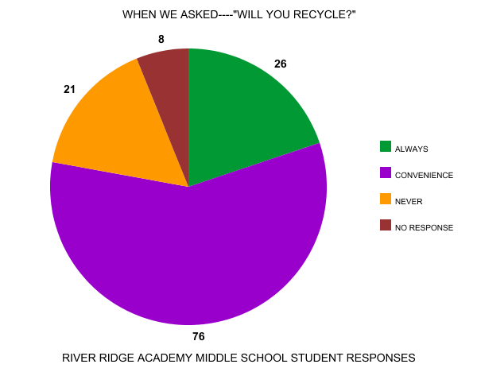

Slide 20
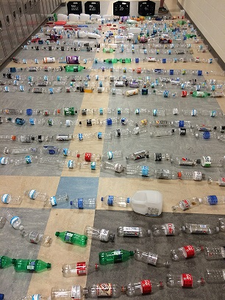
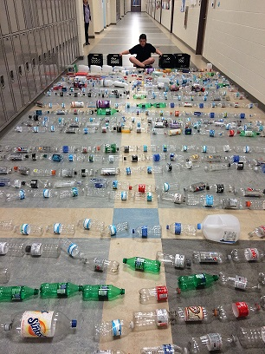
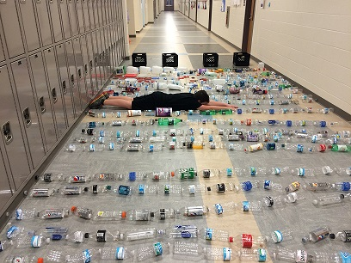
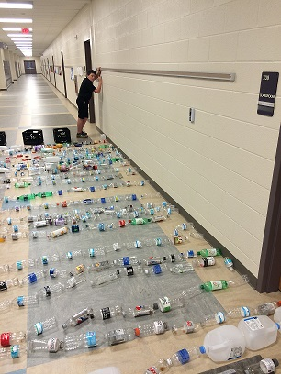
RECYCLING AFTER CLASSROOM CENTERS WERE PUT IN PLACE
Bottles laid out in middle school hall
Perspective of how long
Perspective of width
A man’s work is never done
The team collected plastic recycling from RRA Middle School classrooms. They started with no plastic water bottle recycling and went to 386 plastic water bottles being collected in a 60 day period.

Slide 21
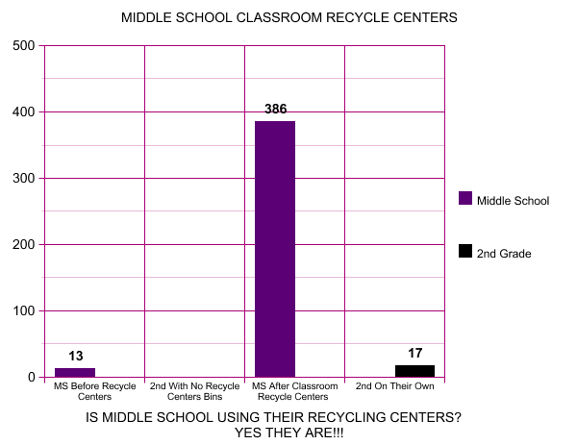
FROM 13 TO 386 IN 60 DAYS!!!

Slide 22
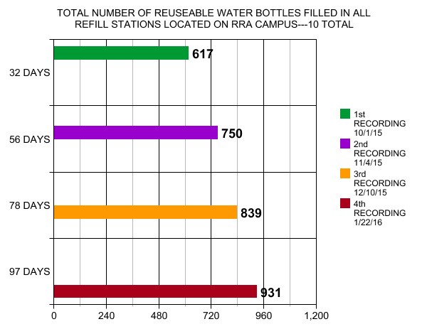
ARE REUSABLE WATER BOTTLES CATCHING ON? YES THEY ARE
Units are in onehundreds, so 617 means 61,700

Slide 23
CONCLUSION
At the conclusion of this experiment it was obvious that the recycling centers placed in the middle school classrooms increased plastic recycling. As a result of the “Awareness Campaign” students began to understand that while recycling was important it was equally important for them to begin using reusable water bottles and refill them at the water fountain refill stations. This was evident from the number of plastic waters/containers collected from the classroom recycling centers and from the increase of usage at the water fountain refill stations.
Community involvement had an impact as well. Having Beaufort County and Publix as partners strengthened the project’s credibility both inside of River Ridge Academy and outside. An example of this was the Bluffton Sun accepting an invitation to come to RRA and interview the teams about the research, experiments and findings of the projects.
As the recycling “Awareness Program” continues at RRA, the data collected will need to be recorded per recycling center collection to include the date and location. This way success can be recorded and specifically measured for each part of the school. In turn, data collected will need to be recorded per water fountain refill station to include date and location. This way success of this part of the experiment can be recorded and specifically measured for each part of the school.
As the “Awareness Program” grows outside of RRA’s walls it will be interesting to see how it will effect the community of Bluffton and beyond.
While recycling is a way for RRA to help the planet and reduce the amount of trash that is placed in the landfills, it is more important to get students to reduce the amount of plastic water bottles used in total. Replacing these with reusable water bottles and refilling them in the water fountain refill stations is a better option for the school and for the environment.
The key to truly protecting the planet is for RRA’s students, staff, families and communities to “reduce” the amount of “trash” they make. “Reducing” trash is and will be the only way to make a difference in everyone’s carbon footprint!

Slide 24
Community Awareness Recordings
http://www.teachertube.com/video/ecybermission-2016-412832 |  | http://www.teachertube.com/video/river-ridge-recycle-campaign-412803
This video was produced for our local T.V. |  | This video was produced for campaign in school wide “huddle”

Slide 25
BIBLIOGRAPHY
1. "Ban the Bottle | A Blog Devoted to Banning Plastic Water ..." 2015. 22 Feb. 2016 <https://www.banthebottle.net/>
2. "Beaufort - DHEC: County Recycling Locations." 2014. 22 Feb. 2016 <http://www.scdhec.gov/HomeAndEnvironment/Recycling/WheretoRecycleLocally/beaufort/>
3. Goldstein, Brian, General Manager Interview "Publix Buckwalter Place, #1205 | Bluffton, SC | Publix Super ..." 2015. 22 Feb. 2016 <http://www.publix.com/locations/1205-buckwalter-place>
4. "How To Start - UFDC Home - University of Florida." 2010. 22 Feb. 2016 <http://ufdc.ufl.edu/UF00028422/00056>
5. Lavery, David. Timeline Productions.
6. "National Geographic Kids: Kids' Games, Animals, Photos ..." 2005. 22 Feb. 2016 <http://kids.nationalgeographic.com/>
7. "One Green Planet | We're your online guide to making ..." 2006. 22 Feb. 2016 <http://www.onegreenplanet.org/>
8. "On Time‐Lapse Photography." 2010. 22 Feb. 2016 <http://davidlavery.net/Collected_Works/Essays/On%20Time-Lapse.pdf>
9. Posthuma, Sam. Bluffton Sun.
10. "Pratt Industries." 2002. 22 Feb. 2016 <http://www.prattindustries.com/>
11. "Shriners Hospital extends clinical reach into Bluffton - The ..." 2015. 22 Feb. 2016 <http://www.blufftonsun.com/shriners-hospital-extends-clinical-reach-into-bluffton-cms-288
12. "TreeHugger | Your source for green design & living news ..." 2002. 22 Feb. 2016 <http://www.treehugger.com/>
13. "What I Learned Today - WordPress.com." 2011. 19 Feb. 2016 <https://wiltoday.wordpress.com/>

